Slide 1
Intrusion Detection by Authorship Analysis
Machine Learning and NLP Approaches
Keith Dyer Security Analytics

Slide 2
Problem Statement
NLP traffic at organizations is high
Zombie malware typically sends out spam or phishing messages.
Spam NLP should be statistically different from normal user
Can we detect zombies via NLP traffic analysis?

Slide 3
Data Collection
Needed a set of NLP data with heavily skewed class balance
ENRON email contained forwarded emails, and other problems
Twitter dataset restricted in length of tweet, not standard NLP.
Reddit data is easily queryable, no size limits, and vary in detail based on response.

Slide 4
Data Collection
Extracted 1000 recent comments from user X, and 100 recent comments from user Y.
Data set break down:
Metric | Value
Average number of words per comment | 43
Shortest comment | 1
Longest comment | 646
Standard Deviation of words per comment | 53.538
Number of Unique Words: | 7313

Slide 5
Feature Extraction
Feature Extraction Techniques Used
Lower case words
Stem words
Remove stopwords
Tokenize on continuous alphabetic sequences. (Binary bag of words)
Extract all n-grams 1-3

Slide 6
Feature Selection
Used three types of feature selection
Best subset of features using GreedyStepwise algorithm
Statistical test from StatisticalAttributeEval
Amir Ahmad, Lipika Dey (2004). A feature selection technique for classificatory analysis.
No selection

Slide 7
Data Set Summary
Dataset | File in Submission Folder | Number of Features | Construction Method
Dataset I | Dataset1_FeatureExtracted.arff | 3322 | - Alphabetic - No Selection
Dataset II | Dataset1_StatisticalFeatureSelection.arff | 324 | - Alphabetic - Statistical
Dataset III | Dataset1_SubsetFeatureSelection.arff | 59 | - Alphabet - CfsSubsetEval
Dataset IV | Dataset1_NGrams_SFE.arff | 4431 | -NGrams(1-3) - Statistical

Slide 8
Summary of Results: Dataset I
Notable Methods | Accuracy | F-Measure (Legitimate) | F-Measure (Intrusive)
SVM with SGD | 91.71% | 0.955 | 0.428
NaiveBayes Multinomial | 91.62% | 0.954 | 0.549

Slide 9
Summary of Results: Dataset II
Notable Methods | Accuracy | F-Measure (Legitimate) | F-Measure (Intrusive)
Voted Perceptron | 94.26% | 0.969 | 0.566
NaiveBayes Multinomial | 96.72% | 0.982 | 0.780

Slide 10
Summary of Results: Dataset III
Notable Methods | Accuracy | F-Measure (Legitimate) | F-Measure (Intrusive)
Logistic Regression | 94.44% | 0.970 | 0.573
NaiveBayes Multinomial | 93.90% | 0.967 | 0.504

Slide 11
Summary of Results: Dataset IV
Notable Methods | Accuracy | F-Measure (Legitimate) | F-Measure (Intrusive)
NaiveBayes Multinomial | 96.90% | 0.983 | 0.795

Slide 12
NLP Approach
Classification Structure: Profile Based with CNG distance metrics
Modified Model from
http://www.icsd.aegean.gr/lecturers/stamatatos/papers/survey.pdf

Slide 13
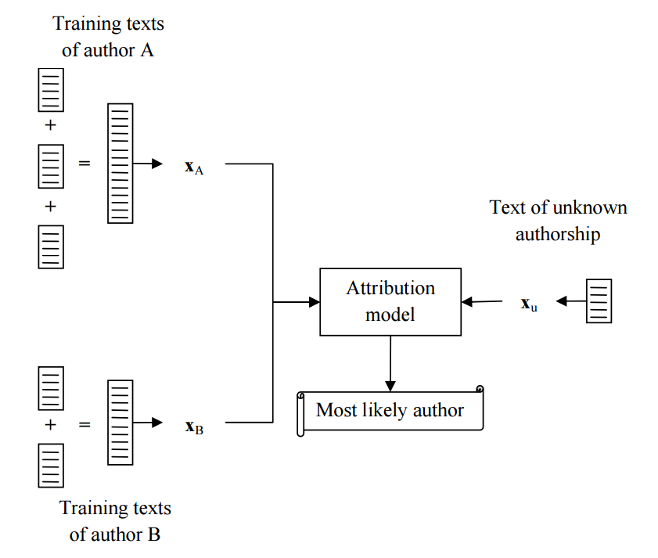
NLP Approach

Slide 14

Distance Metric : CNG
Used Common N-gram method for distance evaluation
Source: Keselj et al, PACLING 2003: N-gram-based author profiles for authorship attribution

Slide 15
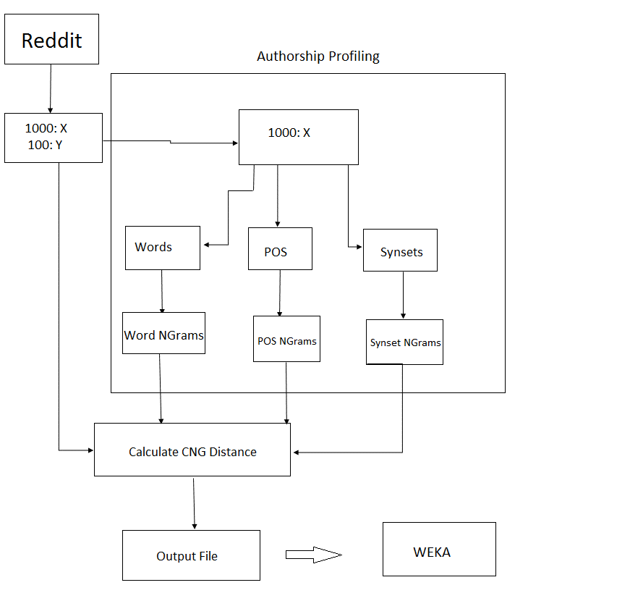

Slide 16
Methods
Word N-grams
POS N-grams
Synset N-grams from WordNet
Training corpus consists of most frequent 5000 n-grams
Evaluated N-grams for unigram, bigram, trigram models.

Slide 17
Information Gain
Feature | Unigram | Bigram | Trigram
CNG-WSD | 0.0531 | 0.1207 | 0.1566
CNG-words | 0.0466 | 0.0709 | 0.0839
CNG-POS | 0.0372 | 0.0421 | 0.0458

Slide 18
Feature Analysis
Trigrams better than Bigrams and Unigrams for all types.
Word Sense Disambiguation was the best feature
Part of Speech alone was a poor feature.

Slide 19
Results
Difficult to find good decision boundaries
Best results from Logistic Regression
10 fold cross-validation
Notable Methods | Accuracy | F-Measure (Legitimate) | F-Measure (Intrusive)
Logistic Regression | 92.81% | 0.961 | 0.470

Slide 20
Possible Further Work
Different distance metric might yield better results.
Statistical test to compare distributions of n-grams might improve results.
Tuning of SVM parameters might improve classification.

Slide 21
Summary
It is possible to detect some intrusive behavior through ML and NLP.
Results not perfect, but might be beneficial as a flag for an expert.
True zombie NLP data might differ more significantly than the test data, especially if it is programmatically generated.

